Slide 1

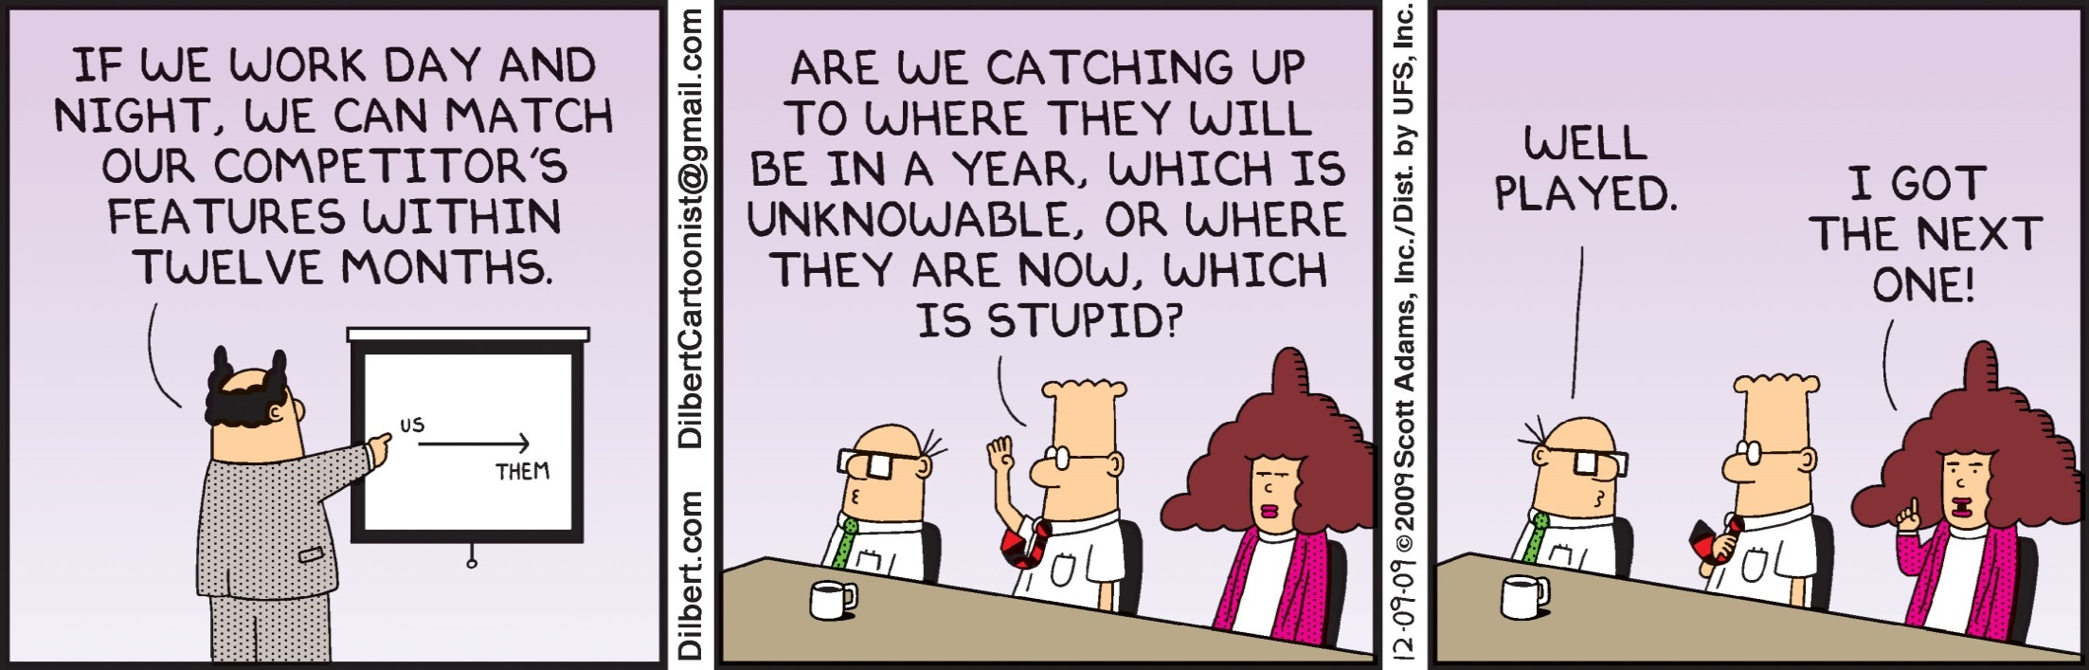
Department of Electronic and Electrical Engineering

Slide 2
Design and analysis of non-uniform
(sample) rate digital controllers
Control Systems Research Group
Dr Samir Khan
Department of Electronic and Electrical Engineering

Slide 3
Previous Loughborough work on processing for Control
1980s – Optimised processing based upon the δ operator
    Aimed towards efficient solutions for micro-controller implementations, etc
      Goodall, R.M. and Donoghue, B.J., ''Very High Sample Rate Digital Filters using the Delta Operator'', Proceedings of Institution of Electrical Engineers - G, 140(3), June 1993, pp 199-206
1990s – Customised processor architectures (the “CSP”)
    Focussed upon FPGA and RISC implementations
      Cumplido, R., Jones, S.R., Goodall, R.M. and Bateman, S., ''A High-Performance Processor for Embedded Real-Time Control'', IEEE Transactions on Control Systems Technology, 13(3), May 2005, pp 485-492
2000s – One-bit processing for control
    More general, scientific investigation, borrowing from the Signal Processing community
      Wu, X., Chouliaras, V., Nunez-Yanez, J.L. and Goodall, R.M., ''A Novel Delta-Sigma Control System Processor and Its VLSI Implementation'', IEEE Transactions on Very Large Integration (VLSI), 163, March 2008, pp 217-228
And now … non-uniform sampling for control processing
    Derived from “alias-free” signal processing concepts
Department of Electronic and Electrical Engineering

Slide 4
Presentation Contents
Research motivation
Sampling, Aliasing and Z-transform
Digital filtering
Frequency Analysis Technique
Example
Department of Electronic and Electrical Engineering
Notes:
Firstly in this presentation I will briefly introduce the concept of HRA.
Then the modelling of a single actutation element will be covered followed by the verification of this model.
The modelling of HRAs based on this single lement model will then be addressed and faults within elements considered.
And finally the effects of faults within HRA assemblies will be talked about and finally some conclusions made.

Slide 5
Research motivation
Overall research aim: Can intentional non-uniform sampling be beneficial for digital control applications?
    in particular to exploit the “alias-free” characteristics, e.g. to enable a lower sample rate, to provide more effective processing overall, etc.
Can the z-transform and emulation techniques be used to generate discrete-time implementations with non-uniform sampling?
    This was addressed in UKACC 2008 in: ‘Implementation of non-uniform sampling for alias-free processing in digital control’ by Khan, Goodall, Dixon
What do non-uniform sampling algorithms consist of?
How can the frequency response be evaluated?
What is necessary practically for physical system implementation?
Department of Electronic and Electrical Engineering

Slide 6
Signal Sampling and Aliasing
x(t)
x(T)
Time
Make a analog signal to be a discrete signal x(t) x(T)
T
x(t)
x(T)
x(T)
Time
Department of Electronic and Electrical Engineering

Slide 7
Signal Sampling and Aliasing
x(t)
x(T)
Time
Drawbacks of slow sampling
Increased phase lags
Drawbacks of fast sampling
Numerical errors arise
Make a analog signal to be a discrete signal x(t) x(T)
T
x(t)
x(T)
x(T)
Introducing a
phase delay
Time
Department of Electronic and Electrical Engineering

Slide 8
Uniform sampling demonstration

Slide 9
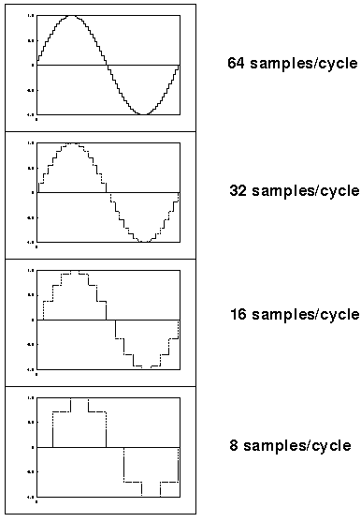
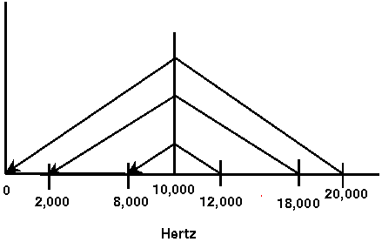
Higher sampling rates allow the waveform to be more accurately represented
Frequencies above Nyquist frequency "fold over" to sound like lower frequencies. This foldover is called aliasing
Department of Electronic and Electrical Engineering

Slide 10
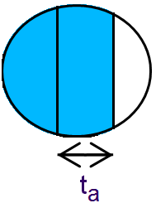
Non-uniform sampling
Several sampling scheme have been investigated with distinct properties in signal processing research eg. Event-based, random
‘Alias-free’ sampling schemes
Uniform distribution of sample times
Sampling mode: t_{i} = t_{i}−1 + (t_{avg} + t_{a}M_{var}), i = 0, 1, 2, . . .
  M_{variation} = ± {0,1,2,3,…}
  t_{avg} = constant value
Potential Advantages:
  No Nyquist limits
  Wider bandwidth
fastest
M_{variation}
slowest
tavg
Department of Electronic and Electrical Engineering

Slide 11
Non-uniform sampling demonstration

Slide 12
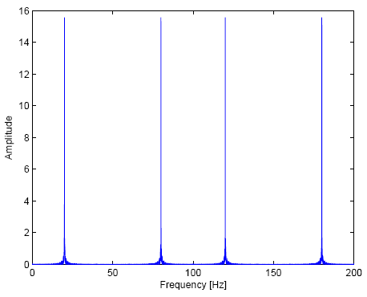
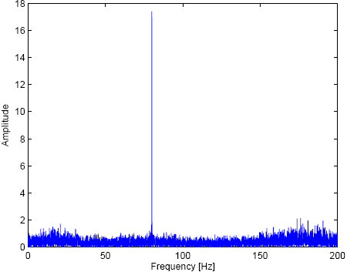
Benefits of non-uniform sampling (“alias-free”)
80 Hz signal sampled with a 100 Hz sampling frequency
Uniformly sampled data Non-uniformly sampled data
Fixed at 100Hz Varying 100Hz ± 30%
original
original
alias
alias
alias
noise floor
Department of Electronic and Electrical Engineering

Slide 13
Z-transform
The jw axis of the s-plane is the location of the Fourier basis function
S-plane
jw
Z
3π
Z
Z
Z
Z
2π
Z
Z
Z
π
Z
x(t)
Z^{-k}
x(T-k)
-π
The z-transform is like Laplace – but discrete
-2π
-3π
The bilinear transform: Z = e^{st} = e^{st/2}/ e^{-st/2}
Z-plane
Im
Inside the unit circle corresponds to the σ<0 part of the s-plane
Outside the unit circle corresponds to σ>0 part of the s-plane
1+sT/2 2 1-Z⁻¹
≈ ---------- = --- -------
1 - sT/2 T 1+Z⁻¹
^{Where T is the sample period}
Re
The unit circle corresponds to the jw axis of the plane, it is the Fourier basis function
Department of Electronic and Electrical Engineering

Slide 14
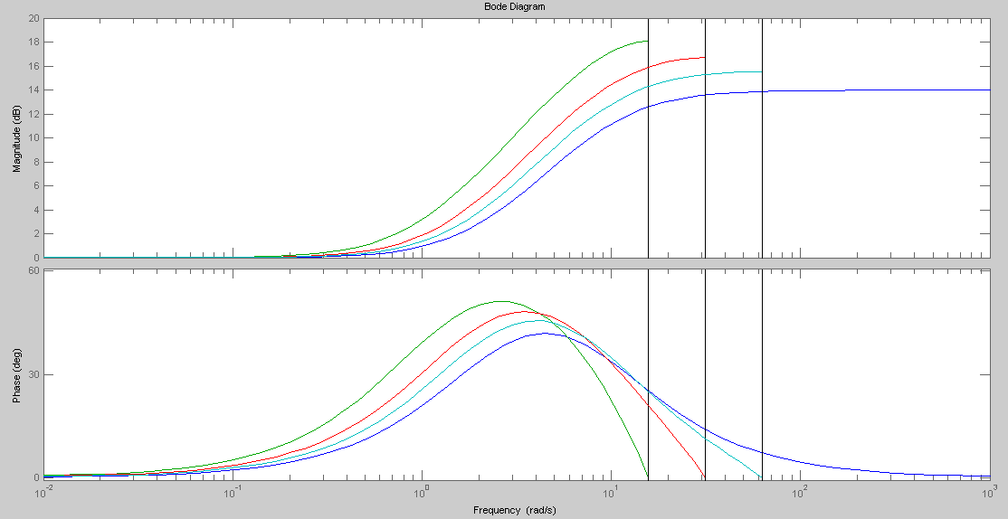
Effect of approximation on frequency response
Department of Electronic and Electrical Engineering

Slide 15



Transfer functions
Consider the general linear time-invariant difference equation:
converted through its Laplace into the Z form:
The difference equation form:
Department of Electronic and Electrical Engineering

Slide 16
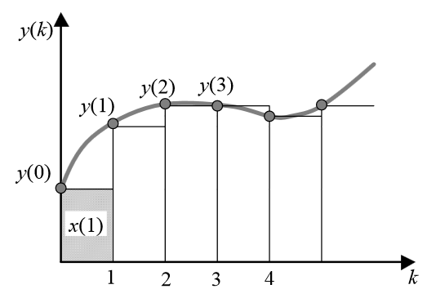
Numerical integration approximation
Department of Electronic and Electrical Engineering

Slide 17

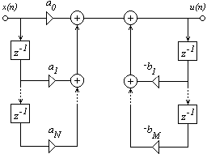
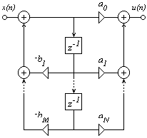

Controller Design
IIR Filters
Structures
Direct form Canonical form
Coefficient recalculation in every iteration
Z⁻¹
Z⁻¹
Z⁻¹
Department of Electronic and Electrical Engineering

Slide 18
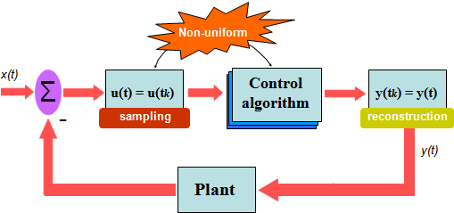
Closed loop setup
Department of Electronic and Electrical Engineering

Slide 19
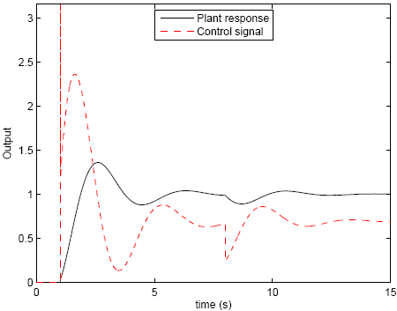
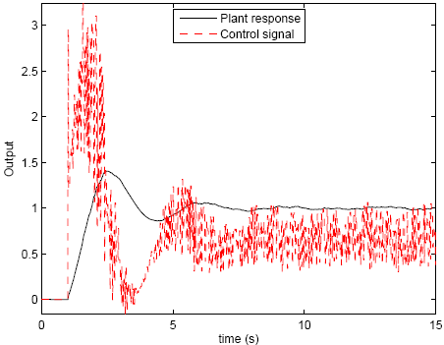
Problems with nonuniformity
Transient issues
Two sets of sample rates used Continuous varying sample time
[0→8s, ts = 0.02s] and [8s→15s, ts = 0.01s] varying [0.01 ±0.0035] sec
Alternatives
Reducing the amount of variation
Uniform filter for each sample rate
Point of sample time change
Department of Electronic and Electrical Engineering

Slide 20
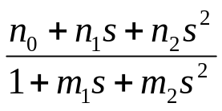
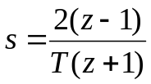
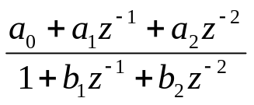
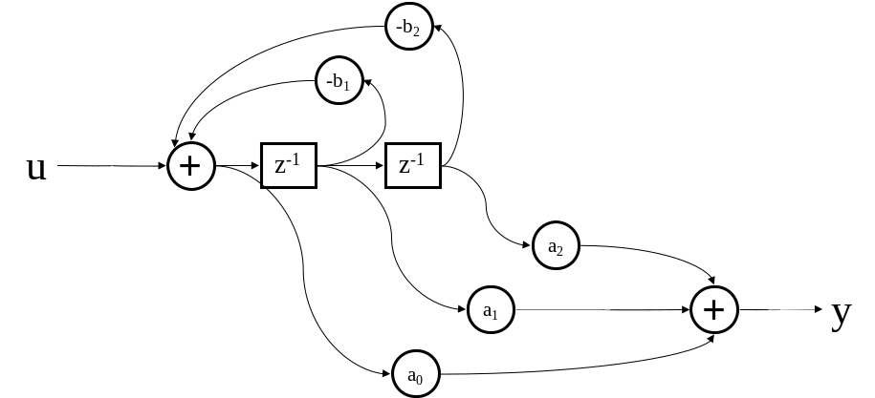
Converting to discrete-time – conventional z operator
T
Sample period
Transform/emulation
process
Continuous
prototype H(s)
Discrete transfer
function H’(z)
Off-line
Real-time
Department of Electronic and Electrical Engineering

Slide 21
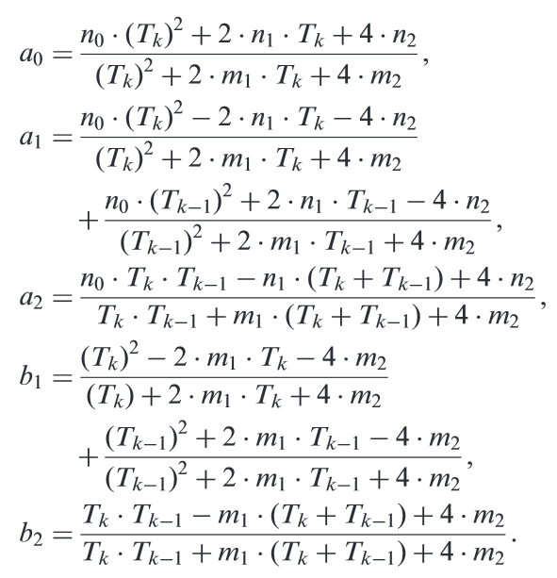
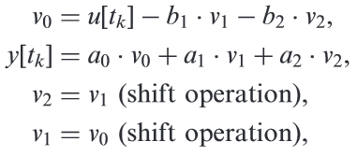
The digital filter coefficients
Difference equ:
Department of Electronic and Electrical Engineering

Slide 22
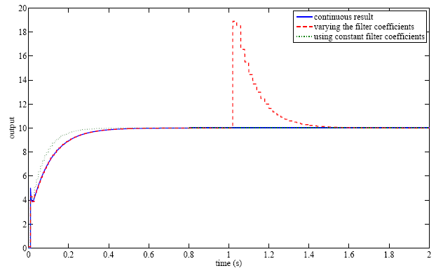

Transient effect of sample rate variation – z operator
Step input applied at t=0
Sample rate changed from 50-100 Hz at t=1
Department of Electronic and Electrical Engineering

Slide 23
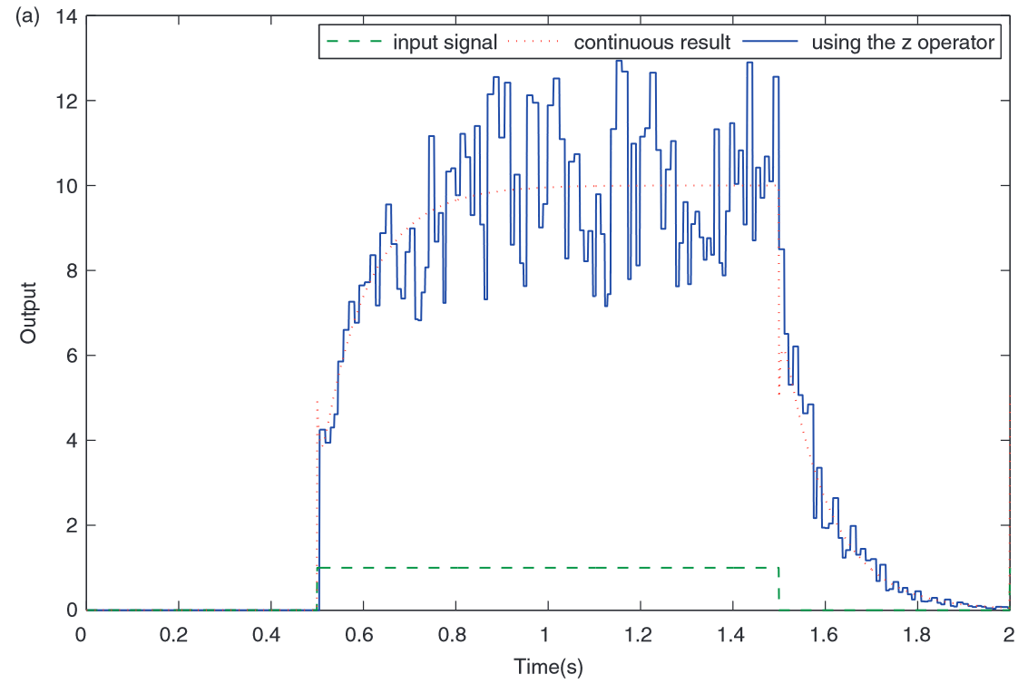
Department of Electronic and Electrical Engineering

Slide 24




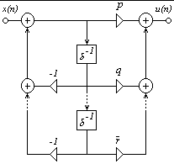
Structure Dependence
Delta transform
The delta operator provides a much superior performance over the z operator
It is less sensitive to parameter change
Provides more suppression for transients
d₁
δ⁻¹
d_{N}
Department of Electronic and Electrical Engineering

Slide 25

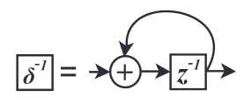
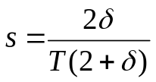
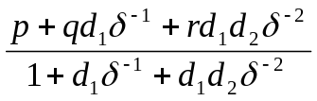
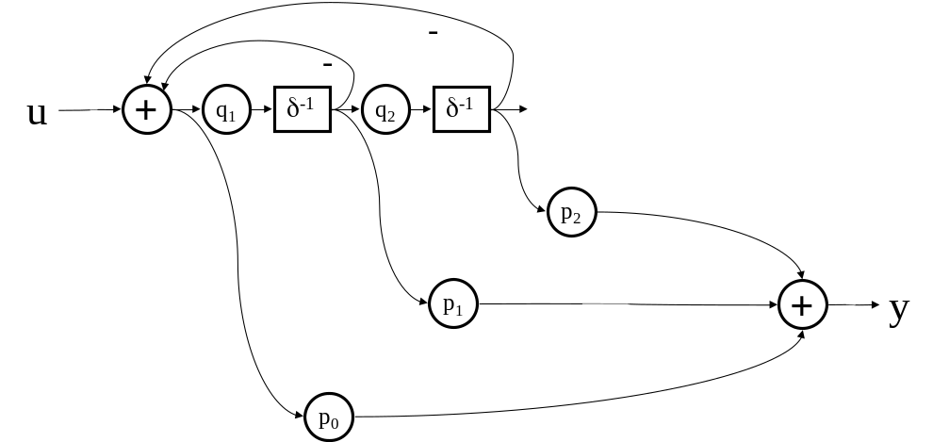
Converting to discrete-time – δ operator
T
Sample period
Transform/emulation
process
Continuous
prototype H(s)
Discrete transfer
function H’(δ)
No transient effects
Department of Electronic and Electrical Engineering

Slide 26
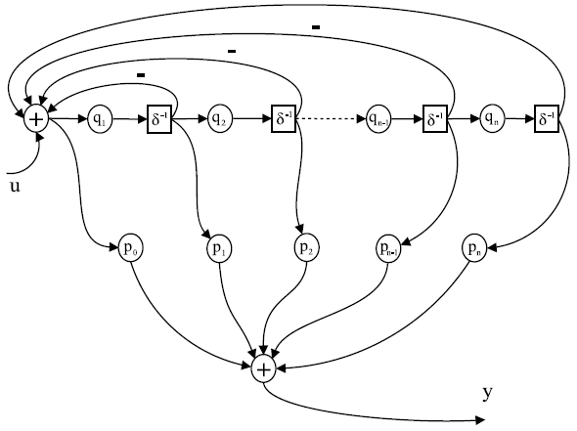

The generalised modified canonic δ filter

Slide 27
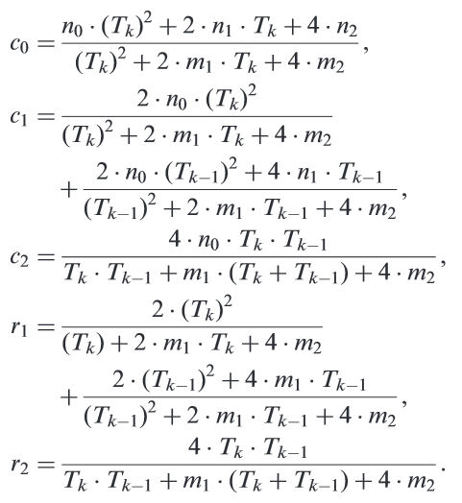

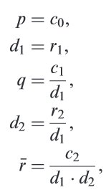
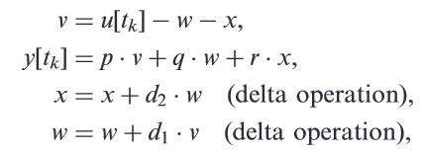
Department of Electronic and Electrical Engineering

Slide 28
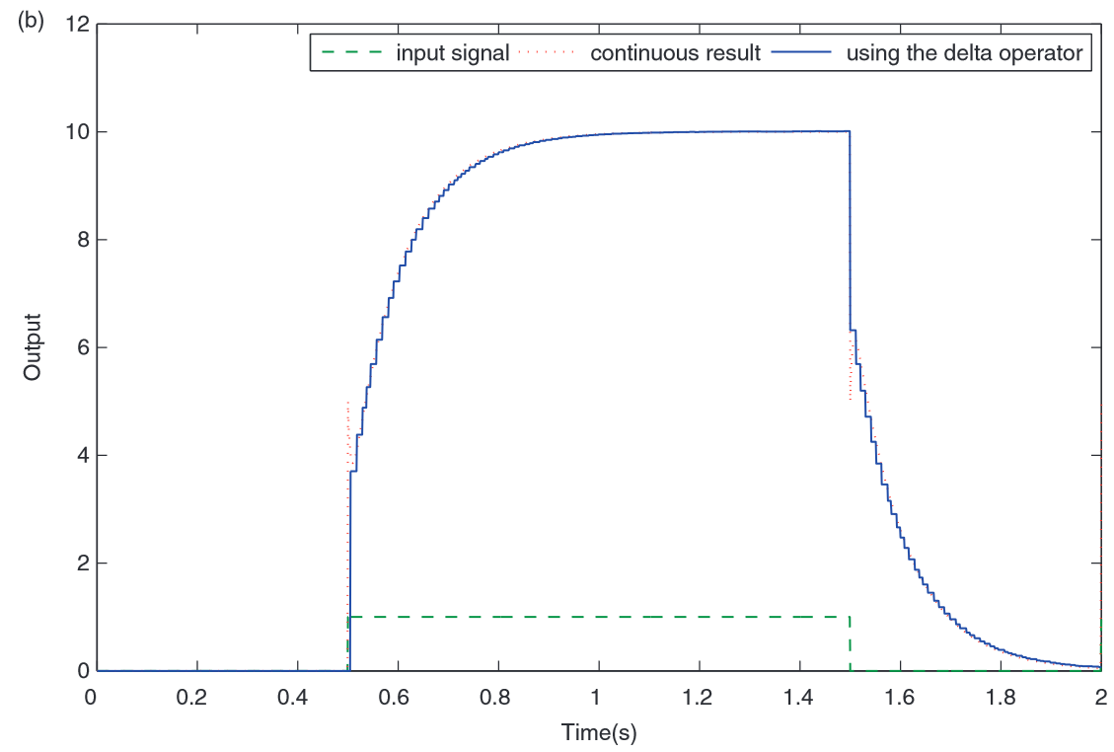
Department of Electronic and Electrical Engineering

Slide 29
Frequency analysis - normal
For Control System Design often use frequency domain methods:-
For continuous transfer functions can substitute s=jω and evaluate to get the steady-state frequency response
For (uniform-sampled) discrete transfer functions can substitute z=e^{jωT} and evaluate to get the steady-state frequency response
No equivalent theory for non-uniform sampling, so …
u(t)
y(t)
Fourier analysis
R(ω)
Sinusoidal input ω
Filter simulation
φ(ω)
Department of Electronic and Electrical Engineering

Slide 30

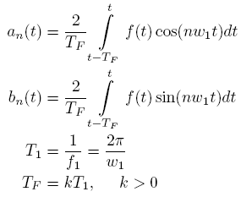
Frequency analysis
Rethinking the basic Fourier definition, a periodic signal f(t) can be expressed by a Fourier series in the form:
The remaining variables can be described as:
where f1 is the fundamental frequency and TF is the integration time being averaged via a moving window over k periods of the fundamental for the Fourier analysis.
The Fourier coefficients are
considered to be functions of time

Slide 31


The magnitude and phase of the observation signal f(t), or the selected harmonic component, can be calculated by the following equations:
After performing the Fourier analysis of the filter output and input signals, the frequency response of the transfer function is computed by:

Slide 32

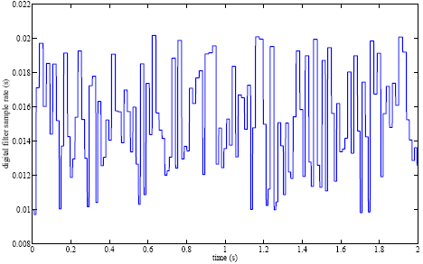
Example
Consider a 2nd order phase lag-lead compensator:
The non-uniform sample rate being used in this exercise has a uniformly distributed set of samples between 0.01s and 0.02s:

Slide 33
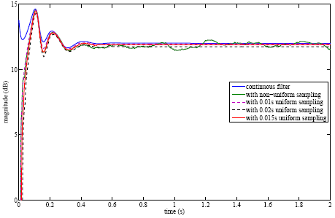
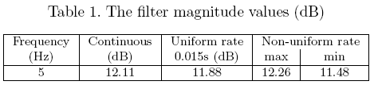
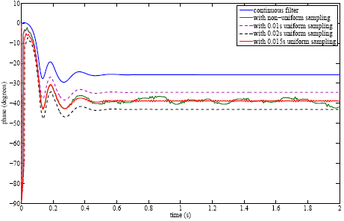
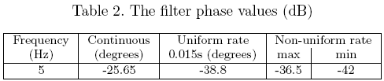
Fourier analysis with a 5Hz input signal
Initial transient phase

Slide 34
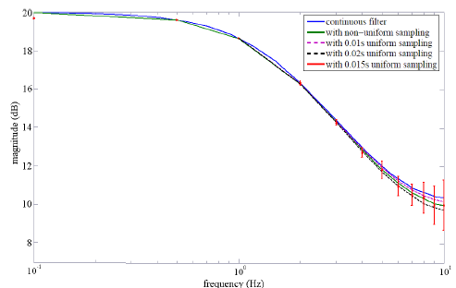
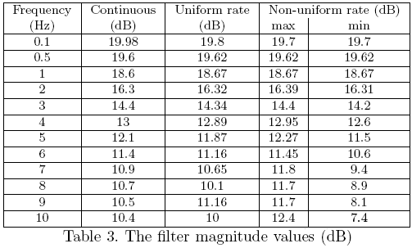
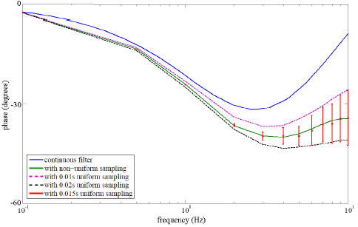
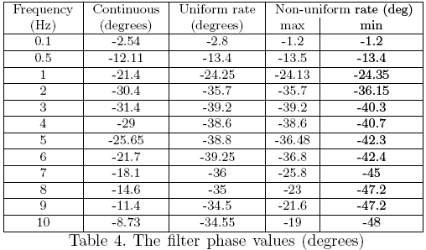
Bode response from Fourier analysis
Effects of sample rate variations

Slide 35
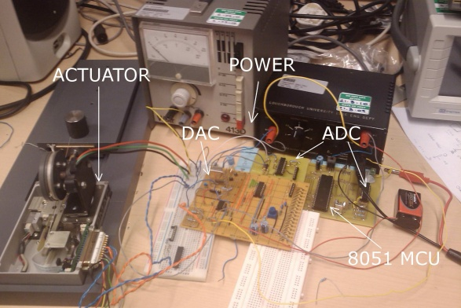
Conclusions
Non-uniform rate sampling for control:-
Significant changes in formulation compared with conventional implementations based on the z operator
Frequency response analysis requires different techniques
Closed-loop non-uniform sample rate controller demonstrated practically
No immediate processing or performance benefits realised
But … more work needed (extrapolation to allow for sample delay, other algorithmic approaches, …)

Slide 36

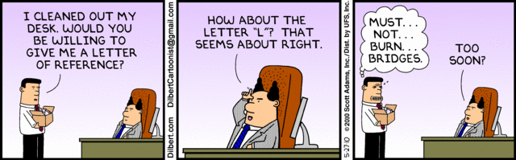
Department of Electronic and Electrical Engineering

Slide 37
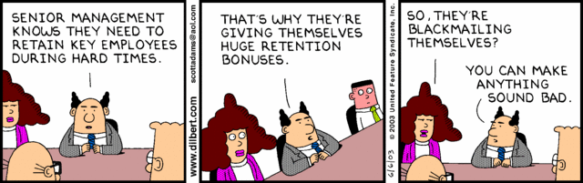
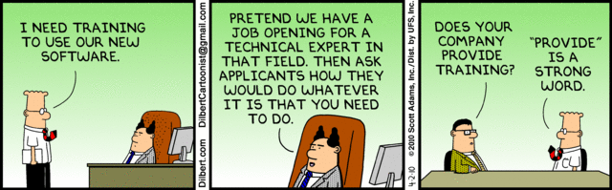
Department of Electronic and Electrical Engineering

